Slide 1
Community Help
There were few government agencies provided aid like there are today
Communities set up Benevolent societies: provided support such as help in case of sickness, unemployment, or death.
Businesses offered small loans to immigrants to open up shops
Settlement Houses were set up, which offered education and social activities to poor immigrants. Ex. Hull House

Slide 2
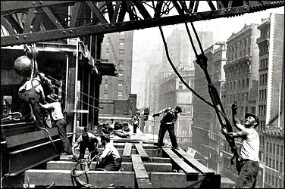
QUESTIONS OF THE DAY:
What factors influenced settlement in certain areas?
What effect did new waves of immigrants have on urban areas?

Slide 3
Factors that influenced settlement
What is a “factor”? A circumstance that influences or contributes to a result or outcome
1) FAMILY
2) JOBS
3) MONEY
4) LOCATION
How? Immigrants needed work. Factories were located in cities= settlement in cities
How? Many immigrants were poor, lived with families in overcrowded and poor neighborhoods.
How?
NYC- close to Ellis Island
Chicago- railroads
How? Many immigrants settled where family was.

Slide 4
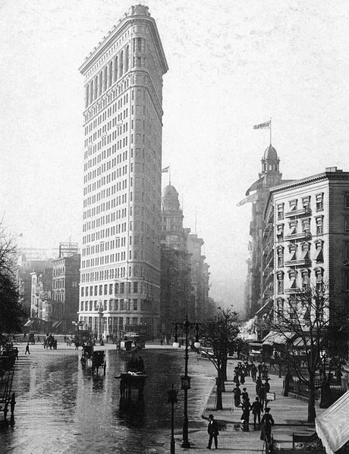
Effects of Immigration on Urban Areas
Effect 1: Growth of Cities
-With the population rapidly growing, cities faced many challenges.
Where will everyone live? Skyscrapers begin to be built because of a lack of space to house people.*Suburbs- neighborhoods outside the city were created
Steel became extremely important in the supporting heavy building structures.
How will everyone get around? With more people being able to live and work in cities, mass transit began.
Cable cars, electric trolleys, underground subways.

Slide 5
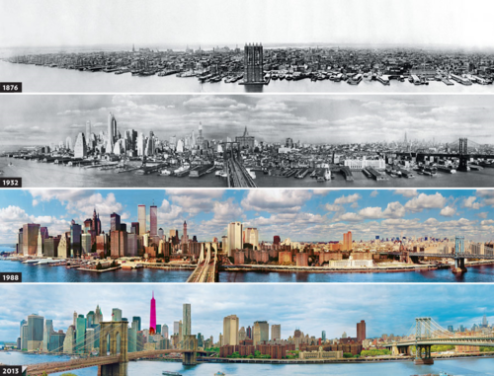

Slide 6
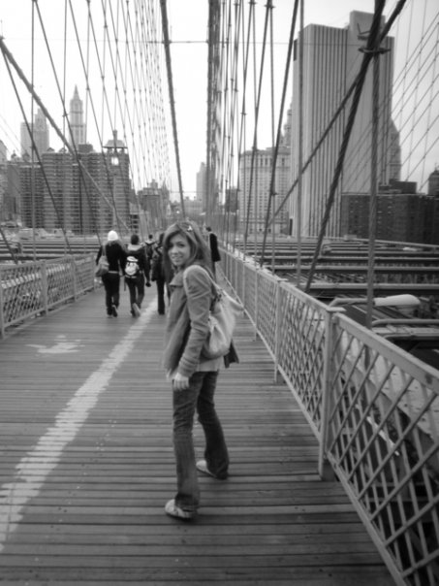
Effects of Immigration on Urban Areas
Effect 2: Growth of Public Projects
-With little space for relaxation, in 1857 New York City dedicated a 700 acre plot of land to build Central Park. Frederick Law Olmsted became the architect after winning a competition.
The Brooklyn Bridge was finished in 1883 and built by German immigrants John and Washington Roebling.
Mass Culture (cultural or leisure activities)also began to develop. Ex- 1904 St. Louis World’s Fair, Coney Island, Department Stores

Slide 7
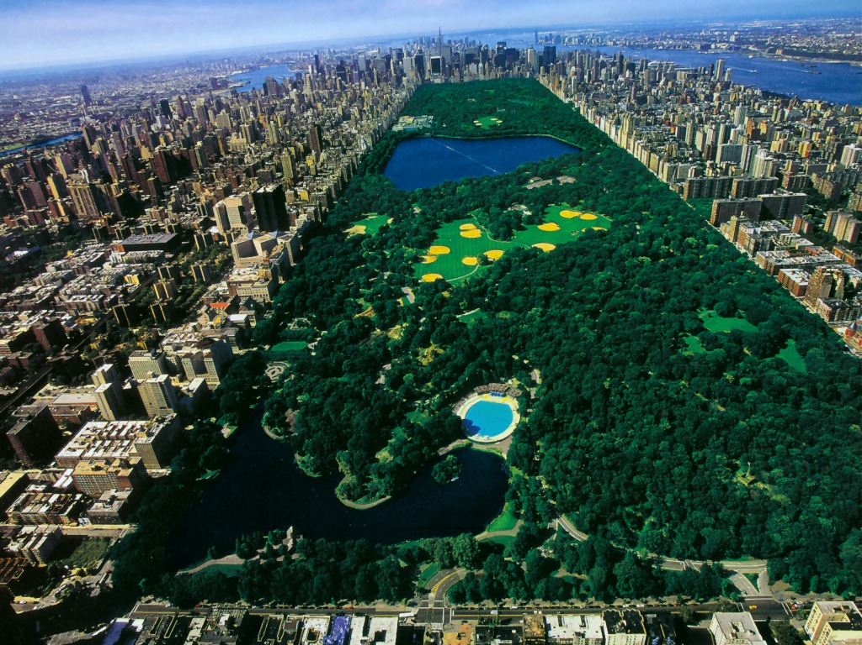
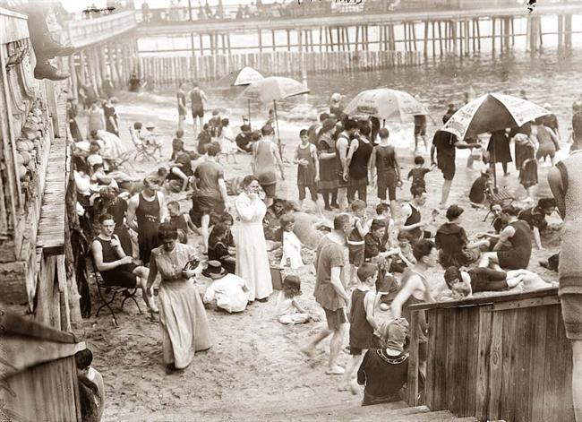
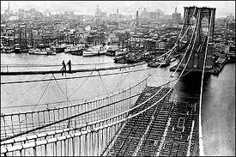
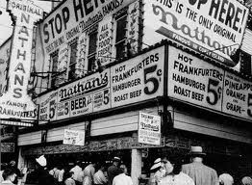

Slide 8
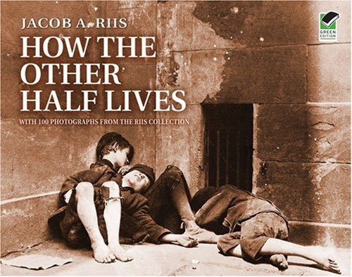
Effects of Immigration on Urban Areas
Effect 3: Urban Problems
-In 1889, Jacob Riis published an account of city life called “How The Other Half Lives.” It included over 100 pictures of tenements in the lower east side.
Sanitation Problems- no collection of garbage
Running water/ clean water was scarce
Air pollution
No laws requiring fire escapes.
"Long ago, ... it was said that 'one half of the world does not know how the other half lives.' ... It did not know because it did not care ... until some flagrant outrage on decency and the health of the community aroused it to noisy but ephemeral indignation.” - Jacob Riis

Slide 9
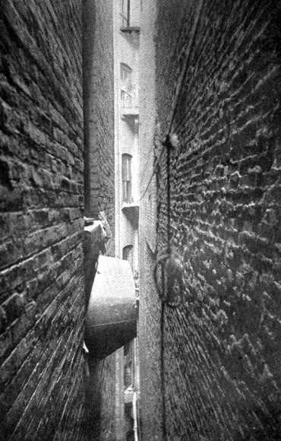
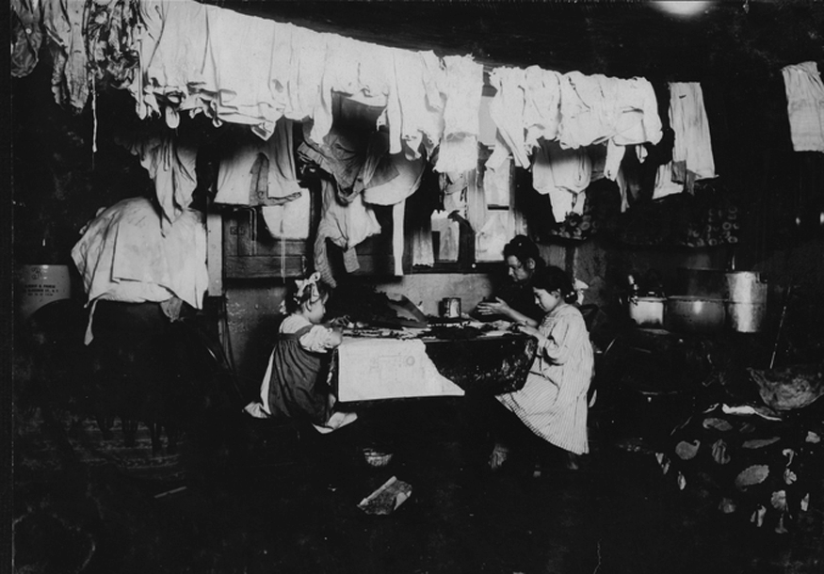
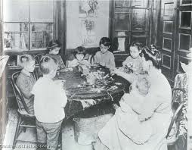
Effects of Immigration on Urban Areas
Effect 3: Urban Problems
As a result of Riis and many others, laws were passed such as the NYS Tenement House Act- to mandate better conditions.
Communities set up “settlement houses” to provide aid to poor immigrants. The Hull House was the most famous of them all and served over 2,000 immigrants a week.
Provided- daycare, English classes, cooking classes, sports, etc.

