Slide 1
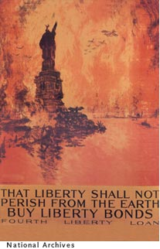
WW1 Propaganda
This piece of propaganda was part of the United States’ effort at mobilizing, or preparing for WW1 by raising money for the war effort for Allied Forces (which included Great Britain, France, and Russia).
At the center of this poster is the Statue of Liberty. I feel that is was chosen because the Statue of Liberty is a symbol of America’s freedom.
The artist of this picture added fighter pilots in the upper right hand corner of this picture to signify the possibility of America being attacked by Central Powers.
The colors of orange, yellow, and red and the quote “Liberty shall now perish from the earth” were used to signify the possibility of America on fire and in ruins if the Allies don’t succeed against the Central Powers.
American Patriotism to this poster is buying supporting the war effort through purchasing “liberty bonds” or war bonds which were certificates purchased b y US citizens that basically loaned money to the US gov’t. In return war bond holders would receive interest later down the road.
War Bonds were responsible for raising 21 billion dollars for the war.

